Slide 1
Introduction to Computer Vision
Dr. Chang Shu
COMP 4900C
Winter 2008

Slide 2
Instructors:
Chang Shu (chang.shu@nrc-cnrc.gc.ca)
Gerhard Roth (GerhardRoth@rogers.com)
Institute for Information Technology
National Research Council
TA: Stefanie Wuhrer
Course website: www.scs.carleton.ca/~c_shu/Courses/comp4900d/
Notes:
Welcome to Introduction to Computer Vision. My name is Chang Shu and I will be teaching this course together with Gerhard Roth. We are adjunct professors of the school of computer science. We work as research scientist at the National Research Council. We do research in computer vision. So we are here to share our knowledge in this area. This is the first time we offer this course at the undergraduate level. Last summer, we ran a directed study course on this. We hope through this course to demonstrate that computer vision is an exciting and useful subject. Hopefully, some of you will continue to study or work in this field.
Our TA is Rossen Atanasov.

Slide 3
What is Computer Vision?
The goal of computer vision is to develop algorithms that allow computer to “see”.
Also called
Image Understanding
Image Analysis
Machine Vision
Notes:
Humans and most animals have eyes.
We use our eyes and our brains to see and visually sense the world around us. Visual perception is the most important sense. A large proportion of our brain is used for processing visual information.
Computer vision is the science that wants to give a similar, if not better, capability to a machine or computer.
Computer vision is concerned with the automatic extraction, analysis and understanding of useful information from a single image or a sequence of images.
It involves the development of a theoretical and algorithmic basis to achieve automatic visual understanding.

Slide 4
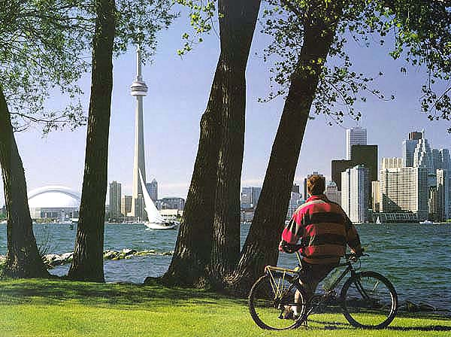
General visual perception is hard

Slide 5
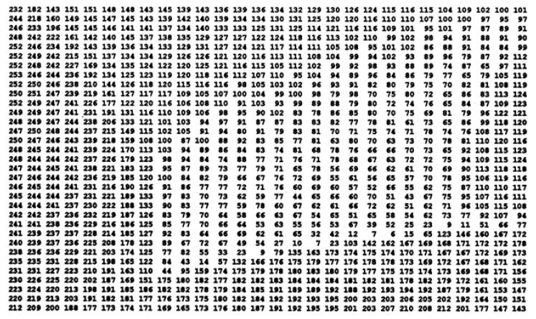
Digital Image

Slide 6
A brief history of computer vision
1960s - started as a student summer project at MIT.
1970s and 80s – part of AI – understanding human vision and emulating human perception.
1990s – depart from AI , geometric approach.
Today – various mathematical methods (statistics, differential equations, optimization), applications (security, robotics, graphics).
Notes:
By late 70s, computers became powerful enough to process images.
Today – commercial systems: ocr, face recognition, industrial measurement and inspection.

Slide 7
What is Computer Vision?
Trucco & Verri:
Computing properties of the 3-D world from one or more digital images.
Properties: mainly physical (geometric, dynamic, etc.)
My favorite:
Computer vision is inverse optics.
Notes:
We say that computer vision is to allow computer to “see”. By seeing, we mean extracting certain meaningful information from the image data. This could be a single image, or a sequence of images.

Slide 8
Related fields
Image Processing
Pattern Recognition
Photogrammetry
Computer graphics
Notes:
Computer vision is closely related to these four fields.
Image processing is to process an input image and generate another image. For example, we can process a fuzzy image caused by out of focus to make it look sharper. Adobe Photoshop. Correcting colors. enhancement.
Pattern Recognition aims at classifying data from prior knowledge or statistics of patterns. For example, character recognition.
Photogrammetry involves measuring 3D information from multiple 2D images. It has applications in ferensics, archeology.
Computer graphics is the inverse of computer vision.

Slide 9
Our Time
It is a good time to do computer vision now, because:
Powerful computers
Inexpensive cameras
Algorithm improvements
Understanding of vision systems
Notes:
We are at an exciting time for doing computer vision.

Slide 10
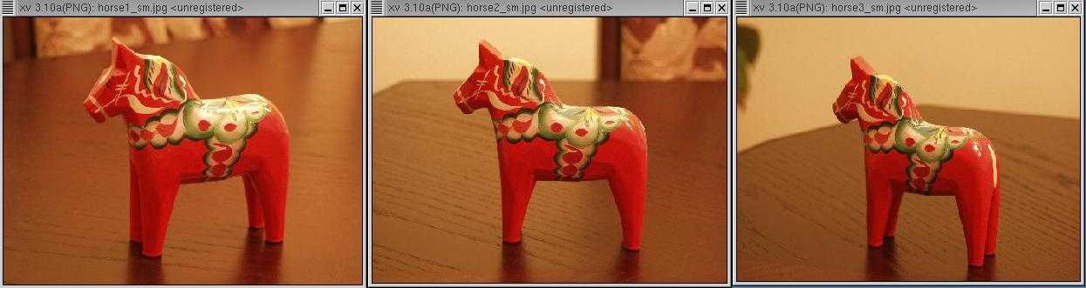
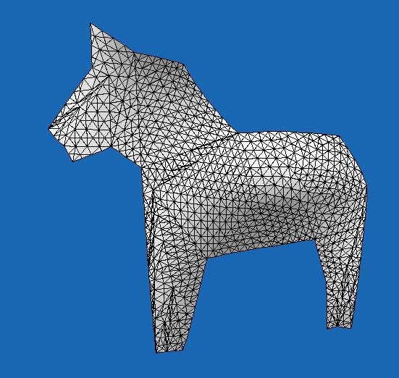
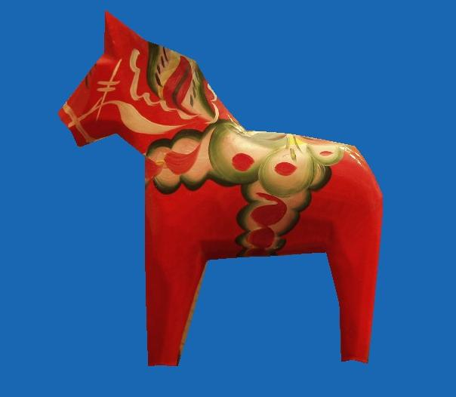
Applications: 3D Reconstruction

Slide 11
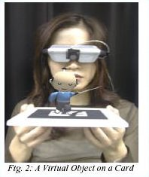
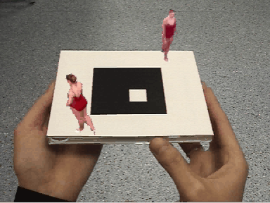
Augmented Reality

Slide 12
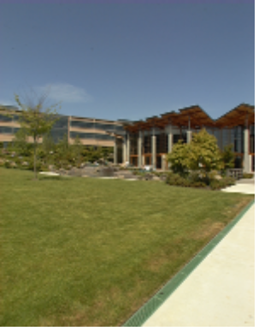
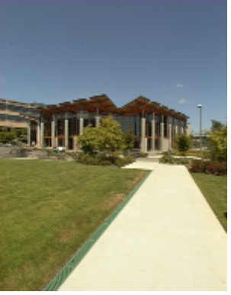
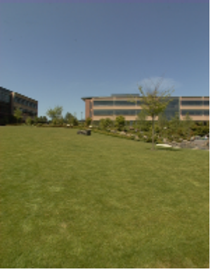
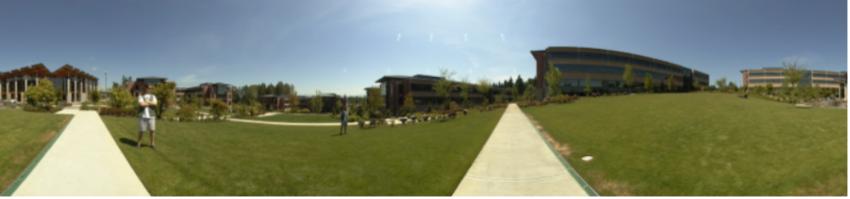
Panoramic Mosaics
+
+ … +
=

Slide 13
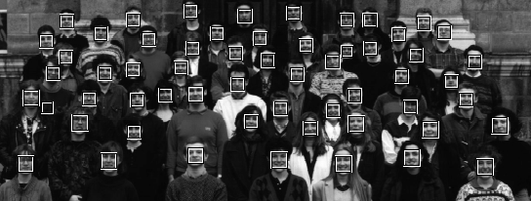
Applications: Recognition

Slide 14
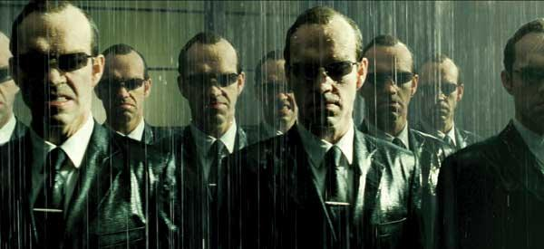
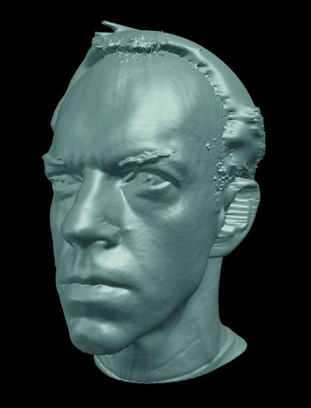
Applications: Special Effects
ESC Entertainment, XYZRGB, NRC

Slide 15



Applications: Special Effects
Andy Serkis, Gollum, Lord of the Rings

Slide 16
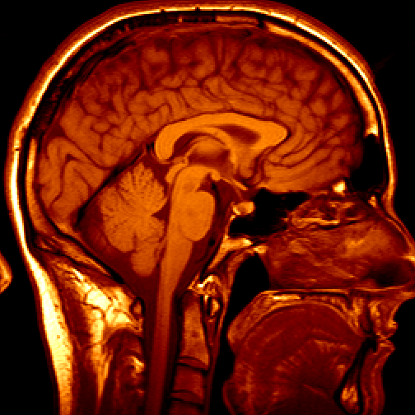
Applications: Medical Imaging

Slide 17
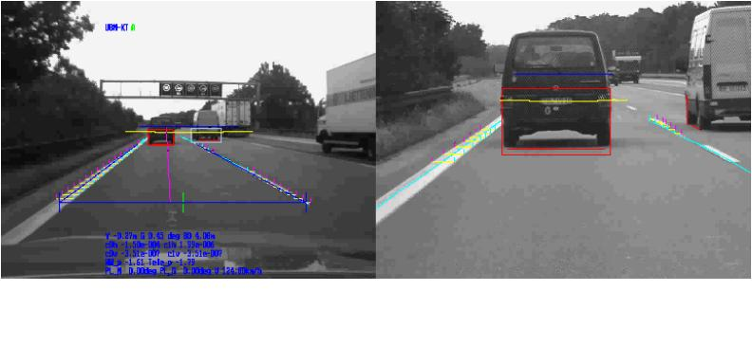
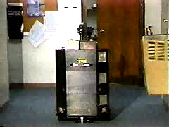
Autonomous Vehicle
Flakey, SRI
Notes:
DARPA (Defense Advanced Research Projects Agency) gave $2 million dollar prize to challenge teams that developed autonomous vehicles to travel long distance across difficult terrains.
The last two competitions were done in the desert. In 2005, the winner is the Stanford University. They completed a 131 mile course in Mojave Desert in under 10 hours.
Last year, the competition is done in an urban environment. The autonomous vehicles are expected to drive in a city together with other human drivers. They should obey traffic laws, handle complex intersections, follow the traffic, overtaking slow vehicles, etc. The winner is a team from the CMU.

Slide 18
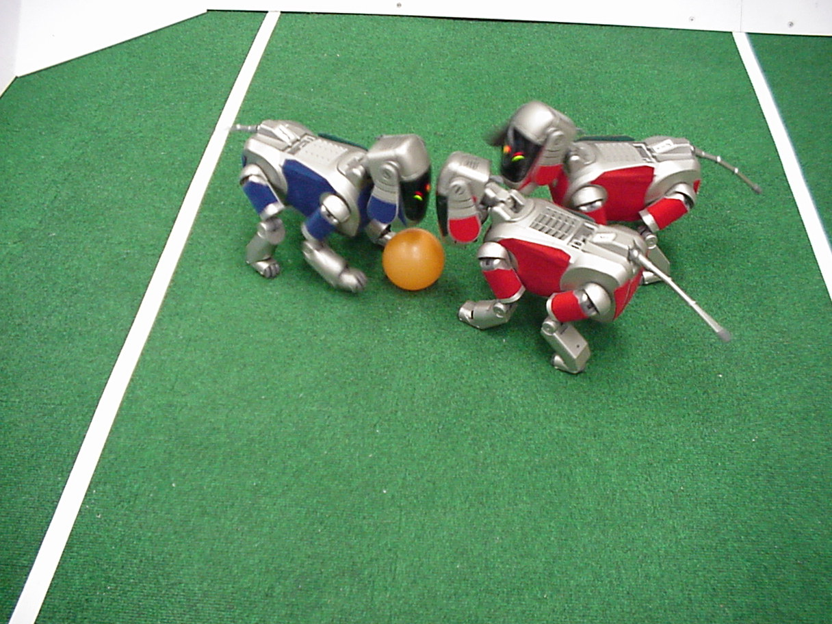
Applications: Robotics
Notes:
This is not a joke. This is RoboCup, an annual international competition. The 2007 game is in Atlanta, USA, and the previous one took place in Osaka, Japan, and next one is in China.
The ultimate goal is to beat a human team by 2050.
This not only entertainment. The technology developed from play soccer by robots can be used, for example, in search and rescue.
Computer vision is not the only technology involved. It need control, mechanical engineering, material sciences, etc.

Slide 19
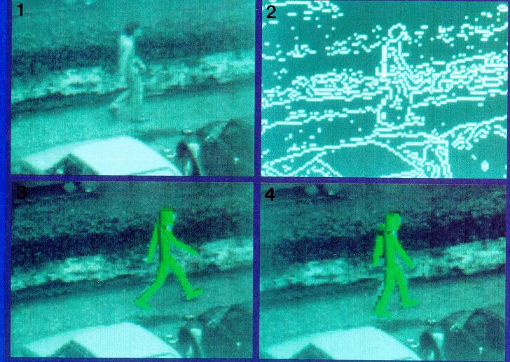
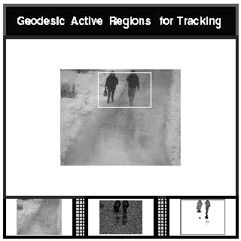
Applications: Surveillance

Slide 20
Mathematical tools
Linear algebra
Vector calculus
Euclidean geometry
Projective geometry
Differential geometry
Differential equations
Numerical analysis
Probability and statistics

Slide 21
Programming tools
OpenCV – an open source library for computer vision.
Ch – a C interpretation environment.

Slide 22
Course Organization
Textbook: Introductory Techniques for 3-D Computer Vision, by Trucco and Verri
Two parts:
Part I (Chang Shu) – Introduction, Review of linear algebra, Image formation, Image processing, Edge detection, Corner detection,
Line fitting, Ellipse finding.
Part II (Gerhard Roth) – Camera calibration, Stereo, Recognition, Augmented reality.

Slide 23
Evaluation
Four assignments (50%)
Two mid-terms (50%)

Slide 24
Programming tools
OpenCV
  A library of routines useful for computer vision
  Open Source system widely used around the world
  Contains many examples and demo programs
  Requires VC++ or Ch interpreter to use
VC++ or Ch
  Assignments normally written in C++ or C
  The easiest way to use the OpenCV library is with
    VC++ 6.0 (examples are on the CD)
    The .net version of VC++ should also work
    Another option is Ch, a C interpreter (also on the CD)
    No advantages over C++ except ease of use (but slower)
Course CD has OpenCV and Ch interpreter

